Slide 1

Data Structures and Algorithms
The Foundations

Slide 2
Acknowledgement
The contents of these slides have origin from School of Computing, National University of Singapore.
We greatly appreciate support from Dr. Steven Halim for kindly sharing these materials.

Slide 3
Policies for students
These contents are only used for students PERSONALLY.
Students are NOT allowed to modify or deliver these contents to anywhere or anyone for any purpose.

Slide 4
Recording of modifications
Currently, there are no modification on these contents.

Slide 5

CS2010 – Data Structures and Algorithms II
Lecture 05 – The Foundations
stevenhalim@gmail.com

Slide 6
Outline of this Lecture
Union‐Find Disjoint Sets (UFDS) Data Structure (CP3 Sec 2.4.2)
http://visualgo.net/ufds.html
Bitmask Data Structure (CP3 Section 2.2)
http://visualgo.net/bitmask.html
Motivation on why you should learn graph
Very quick review on graph terminologies (from CS1231)
Three Graph Data Structures (CP3 Section 2.4.1)
Adjacency Matrix
Adjacency List
Edge List
http://visualgo.net/graphds.html

Slide 7
A simple yet effective data structure to model disjoint sets… This DS will be revisited in Week 07 during lecture on MST http://visualgo.net/ufds.html
CP3, Section 2.4.2
UNION‐FIND DISJOINT SETS DATA STRUCTURE

Slide 8
Union‐Find Disjoint Sets (UFDS)
Given several disjoint sets initially…
Union two disjoint sets when needed
Find which set an item belongs to
More typical usage: To check if two items belong to the same set
Key ideas (see the figures in the next few slides):
Each set is modeled as a tree
Thus a collection of disjoint sets form a forest of trees
Each set is represented by a representative item
Which is the root of the corresponding tree of that set

Slide 9
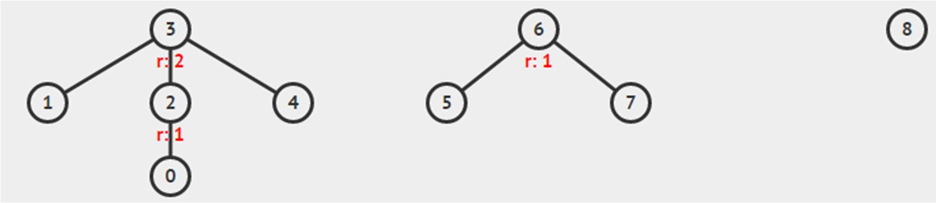
Example with 3 Disjoint Sets
There are three disjoint sets (trees) in the figure below:
1. Set that contains {0, 1, 2, 3, 4}
– Representative item = vertex 3, highlighted with bold + underline,
the root of that subtree
Set that contains {5, 6, 7}
Set that contains {8}

Slide 10
Representation of UFDS
We can record this forest of trees with an array p
p[i] records the parent of item i
if p[i] = i, then i is a root
– And also the representative item of this set
For the example below, we have p = {2,3,3,3,3,6,6,6,8}
0,1,2,3,4,5,6,7,8

Slide 11
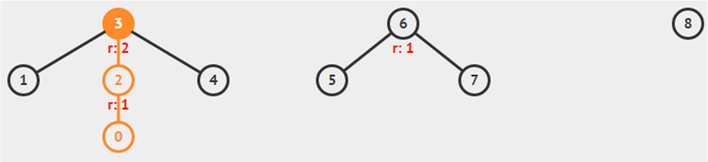
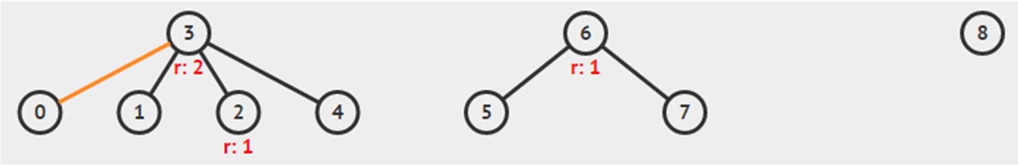
UFDS – FindSet Operation
For each item i, we can find the representative item
of the set that contains item i by recursively visiting p[i] until p[i] = i; Then, we compress the path to make future find operations (very) fast, i.e. O(1)
Example of findSet(0)

Slide 12
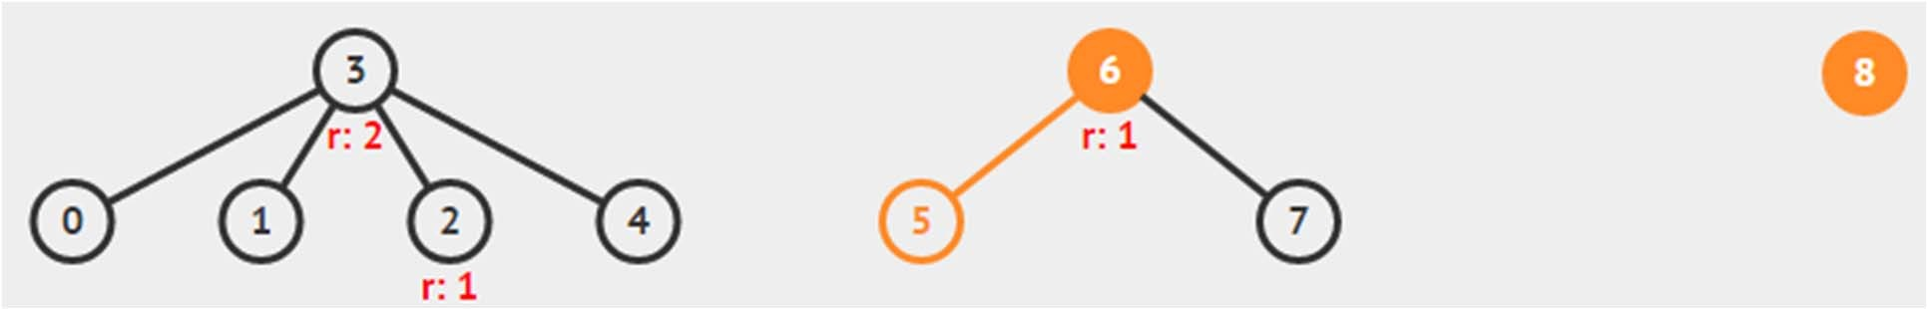
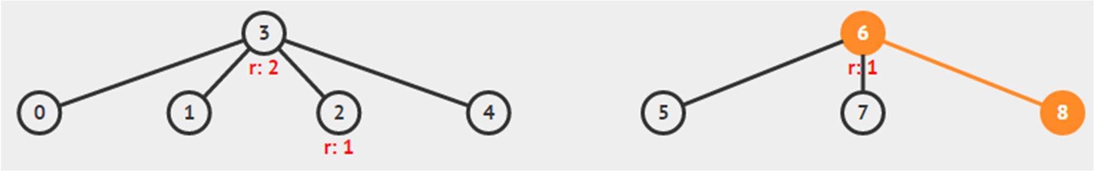
UFDS – UnionSet Operation (1)
If two items A and B are currently belong to different disjoint sets, we can union them by setting the representative item of the one with higher* tree
to be the new representative item of the combined set
Example of unionSet(5, 8)

Slide 13
UFDS – UnionSet Operation (2)
This is called the “Union‐by‐Rank” heuristic
This helps to make the resulting combined tree shorter
– Convince yourself that doing the opposite action
will make the resulting tree taller (we do not want this)
If both trees are equally tall, this heuristic is not used
We use another array rank[i] to store the upper bound of the height of (sub)tree rooted at i
This is just an upper bound as path compressions can make (sub)trees shorter than its upper bound and we do not want to waste effort maintaining the correctness of rank[i]

Slide 14
Constructor, e.g. UnionFind(5)
class UnionFind { // OOP style
private Vector<Integer> p, rank;
public UnionFind(int N) {
p = new Vector<Integer>(N); rank = new Vector<Integer>(N); for (int i = 0; i < N; i++) {
p.add(i);
rank.add(0);
}
}
// ... other methods in the next
few slides
}

Slide 15
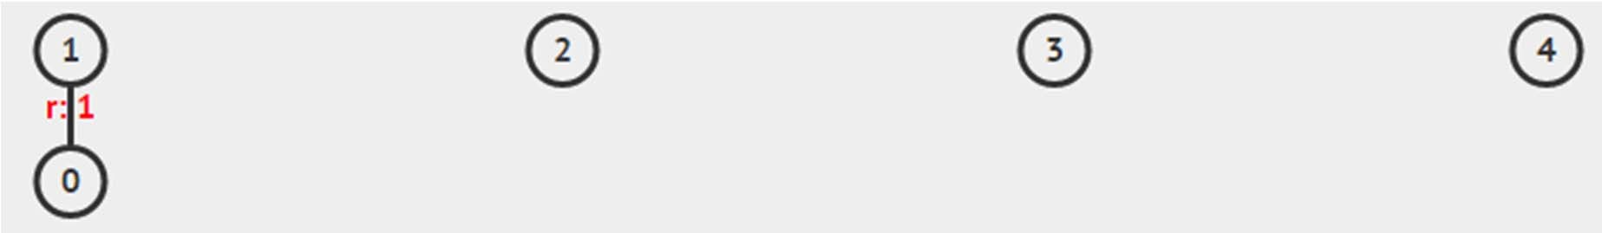
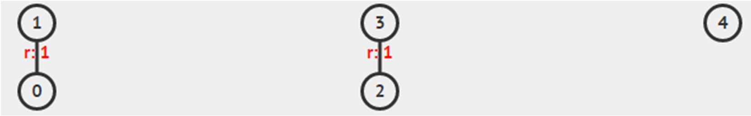
unionSet(0, 1) then unionSet(2, 3)
public void unionSet(int i, if (!isSameSet(i, j)) {
int x = findSet(i), y =
// rank is used to keep
int j) {
findSet(j);
the tree short
if (rank.get(x) > rank.get(y)) p.set(y, x);
else {
p.set(x, y);
if (rank.get(x) == rank.get(y)) // rank
increases
rank.set(y, rank.get(y)+1); // only if both trees
// initially have the same rank
}
}
}

Slide 16
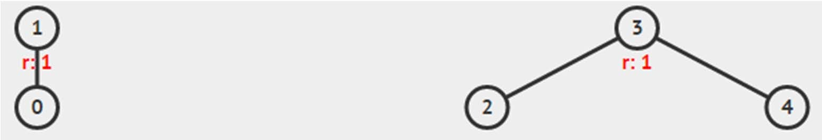
unionSet(4, 3)
public void unionSet(int i, if (!isSameSet(i, j)) {
int x = findSet(i), y =
// rank is used to keep
int j) {
findSet(j);
the tree short
if (rank.get(x) > rank.get(y)) p.set(y, x);
else {
p.set(x, y);
if (rank.get(x) == rank.get(y)) // rank
increases
rank.set(y, rank.get(y)+1); // only if both trees
// initially have the same rank
}
}
}

Slide 17
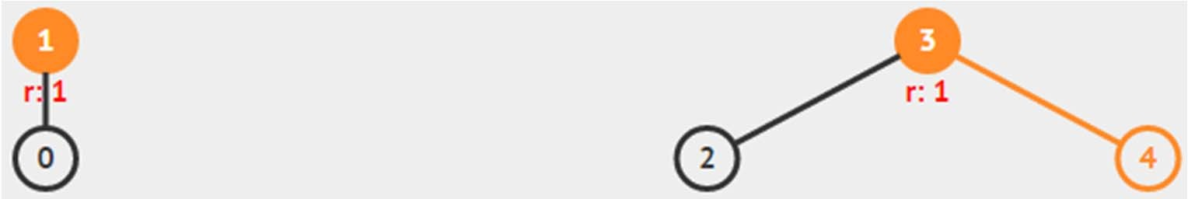
isSameSet(0, 4)
public Boolean isSameSet(int i, int j) { return findSet(i) == findSet(j);
}
As the representative items of the sets that contains item 0 and 4 are different, we say that 0 and 4 are not in the same set!

Slide 18
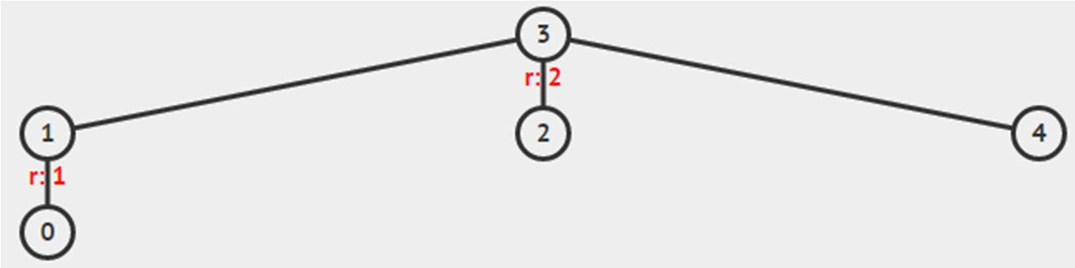
unionSet(0, 3)
public void unionSet(int i, if (!isSameSet(i, j)) {
int x = findSet(i), y =
// rank is used to keep
int j) {
findSet(j);
the tree short
if (rank.get(x) > rank.get(y)) p.set(y, x);
else {
p.set(x, y);
if (rank.get(x) == rank.get(y)) // rank
increases
rank.set(y, rank.get(y)+1); // only if both trees
// initially have the same rank
}
}
}

Slide 19
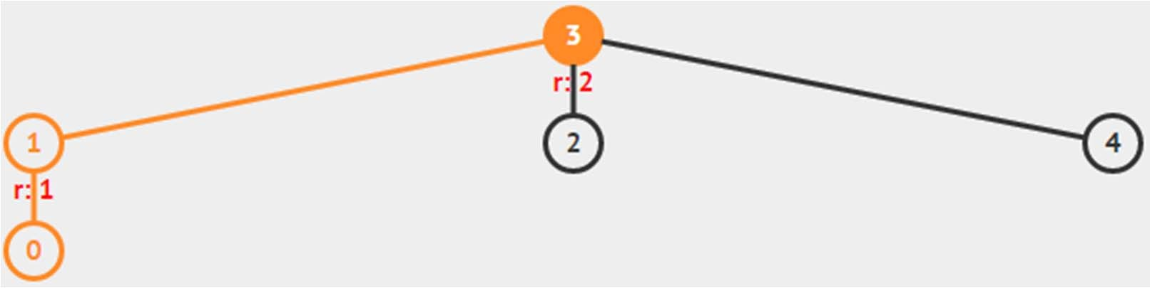
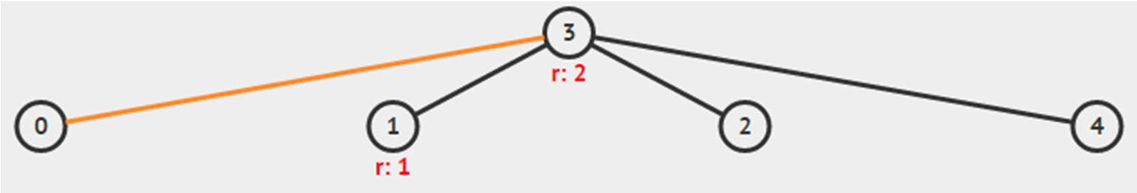
findSet(0)
Note, I have to first set the new value of p[i] before returning the new value, because method
set() in Java Vector returns the element previously at the specified position, i.e. I cannot use:
return p.set(i, findSet(p.get(i));
public int findSet(int i) { if (p.get(i) == i) return i; else {
int ret = findSet(p.get(i)); p.set(i, ret);
return ret;
}
}

Slide 20
UFDS – Summary
That’s the basics… we will not go into further details
UFDS operations runs in just O(α(V)) if UFDS is implemented with both “union‐by‐rank” and “path‐compression” heuristics
α(V) is called the inverse Ackermann function
This function grows very slowly
You can assume it is “constant”, i.e. O(1) for practical values of V (< 1M)
The analysis is quite hard and not for CS2010 level :O
Further References:
Introductions to Algorithms, p505‐509 in 2nd ed, ch 21.3
CP3, Section 2.4.2 (UFDS) and 4.3.2 (MST, Kruskal’s)
Algorithm Design, p151‐157, ch 4.6
http://visualgo.net/ufds.html

Slide 21
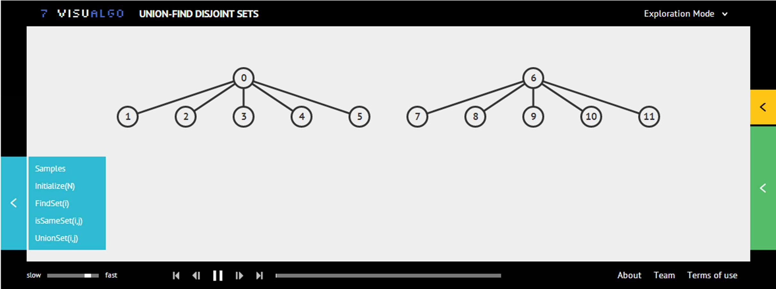
VisuAlgo UFDS Exercise (1)
First, click “Initialize(N)”, enter 12, then click “Go”
Do a sequence of union and/or find operations to get the screen shot below (Samples: 2 Trees of Rank 1)

Slide 22
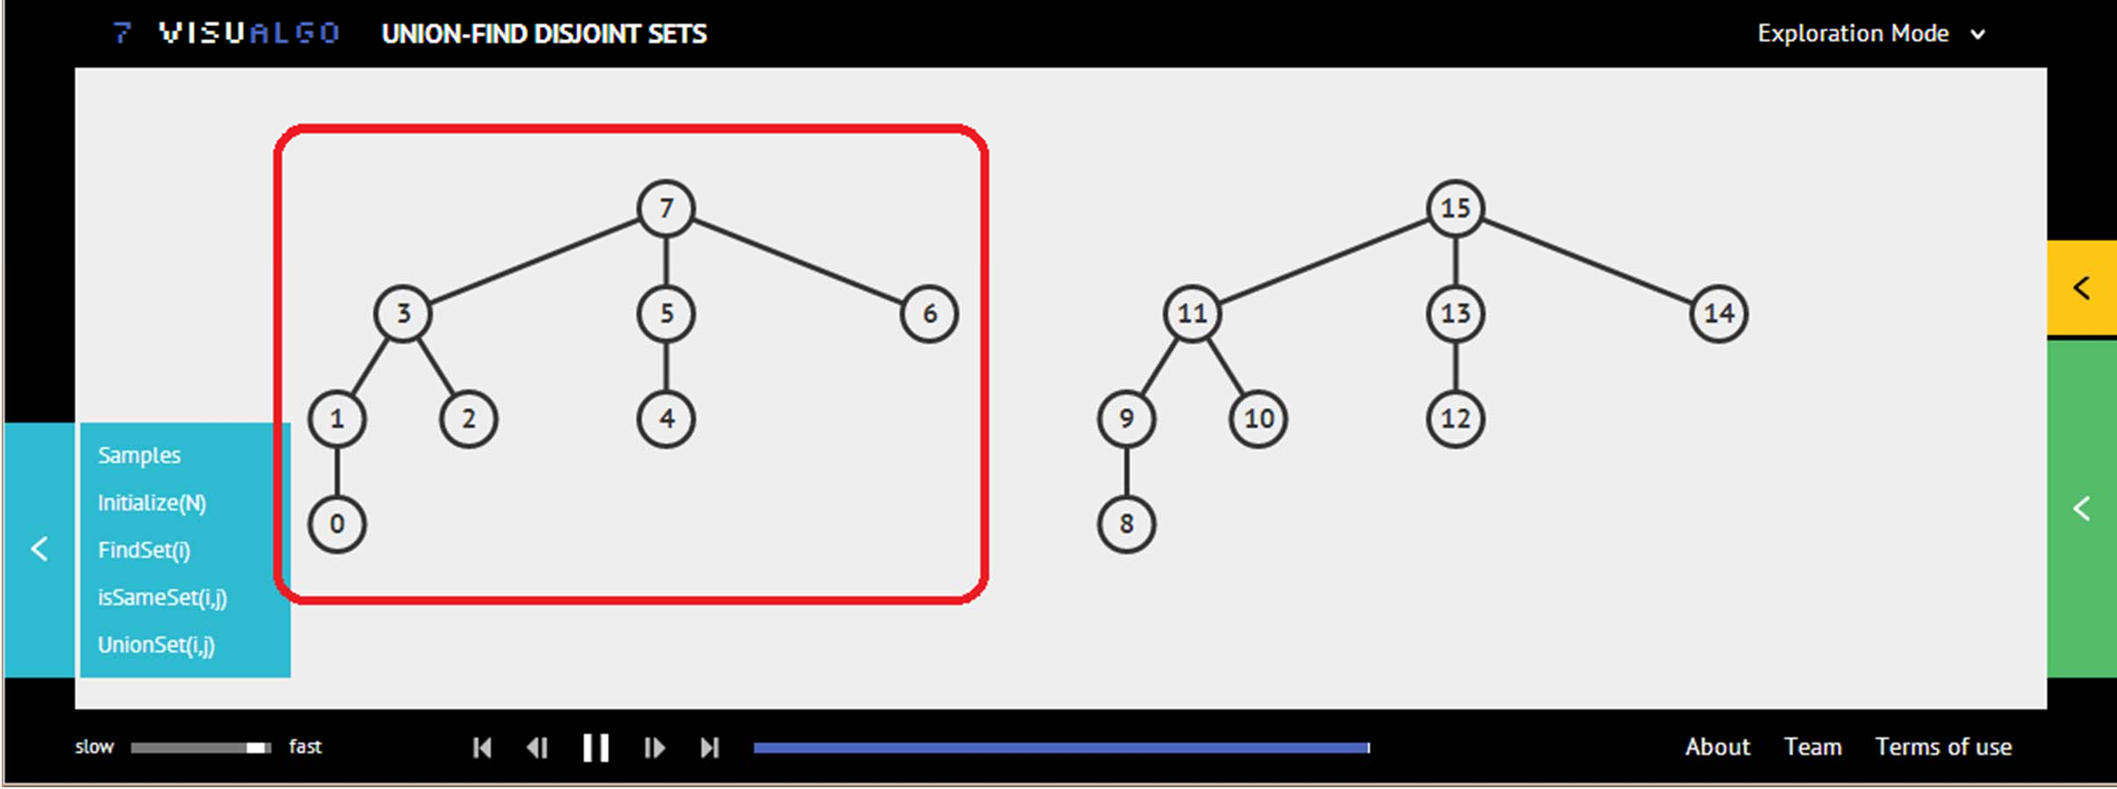

VisuAlgo UFDS Exercise (2)
First, click “Initialize(N)”, enter 8, then click “Go”
Do a sequence of union and/or find operations to get the left subtree of (Samples: 2 Trees of Rank 3)

Slide 23
Interesting way to model a lightweight (small) set of Booleans… This DS will be revisited in Week 11 during lecture on TSP http://visualgo.net/bitmask.html
CP3, Section 2.2
BITMASK DATA STRUCTURE

Slide 24
Lightweight (Small) Set of Booleans
An integer is stored in binary in computer memory
int x = 7₁₀ (base 10/decimal) is actually 111₂ (base 2/binary)
• int y = 12₁₀ is 1100₂
• int z = 83₁₀ is 1010011₂
We can use this sequence of 0s and 1s to represent a small set of Boolean very efficiently
N‐bits integer can represent N Boolean objects
Theoretically up to 32 Boolean objects for a 32‐bit integer
If i‐th bit is 1, we say object i is in the set/active/used Otherwise, object i is not in the set/not active/not used

Slide 25
Bit Operations (1)
To check whether bit i is on or off in x, we use x & (1<<i)
Example:
– x = 25₁₀ (11001₂), check if bit i= 2 (from right, 0‐based indexing) is on
– x & (1<<2) = 25₁₀ & 4₁₀
11001₂
00100₂
‐‐‐‐‐‐‐‐ & (bitwise AND operation) 00000₂
– The result is 0₁₀ (00000₂), that means bit i = 2 (from right) is off

Slide 26
Bit Operations (2)
To check whether bit i is on or off in x, we use x & (1<<i)
Example:
– x = 25₁₀ (11001₂), check if bit i= 3 (from right, 0‐based indexing) is on
– x & (1<<3) = 25₁₀ & 8₁₀
11001₂
01000₂
‐‐‐‐‐‐‐‐ & (bitwise AND operation) 01000₂
– The result is 8₁₀ (01000₂), that means bit i = 3 (from right) is on

Slide 27
Bit Operations (3)
To turn on bit i of an integer x, we use x = x | (1<<i)
Example:
x = 25₁₀ (11001₂), turn on bit i= 2 (from right, 0‐based indexing)
– x = x | (1<<2) = 25₁₀ | 4₁₀ = 11001₂
00100₂
‐‐‐‐‐‐‐‐ | (bitwise OR operation) 11101₂
x = 29₁₀ (11101₂) now, bit 2 (from right) is now turned on

Slide 28
Bit Operations (4)
To turn on bit i of an integer x, we use x = x | (1<<i)
Example:
x = 25₁₀ (11001₂), turn on bit i= 3 (from right, 0‐based indexing)
– x = x | (1<<3) = 25₁₀ | 8₁₀ = 11001₂
01000₂
‐‐‐‐‐‐‐‐ | (bitwise OR operation) 11001₂
x = 25₁₀ (11001₂), no change as bit 3 (from right) is already on

Slide 29
Bit Operations (5)
To turn on all bits of a set of Boolean with size n, we use x = (1<<n) ‐ 1
Example:
– n = 4
– 1<<4 = 16₁₀ (10000₂)
– x = (1<<4) ‐ 1 = 15₁₀ (1111₂)
Notice that all n = 4 bits are turned on

Slide 30
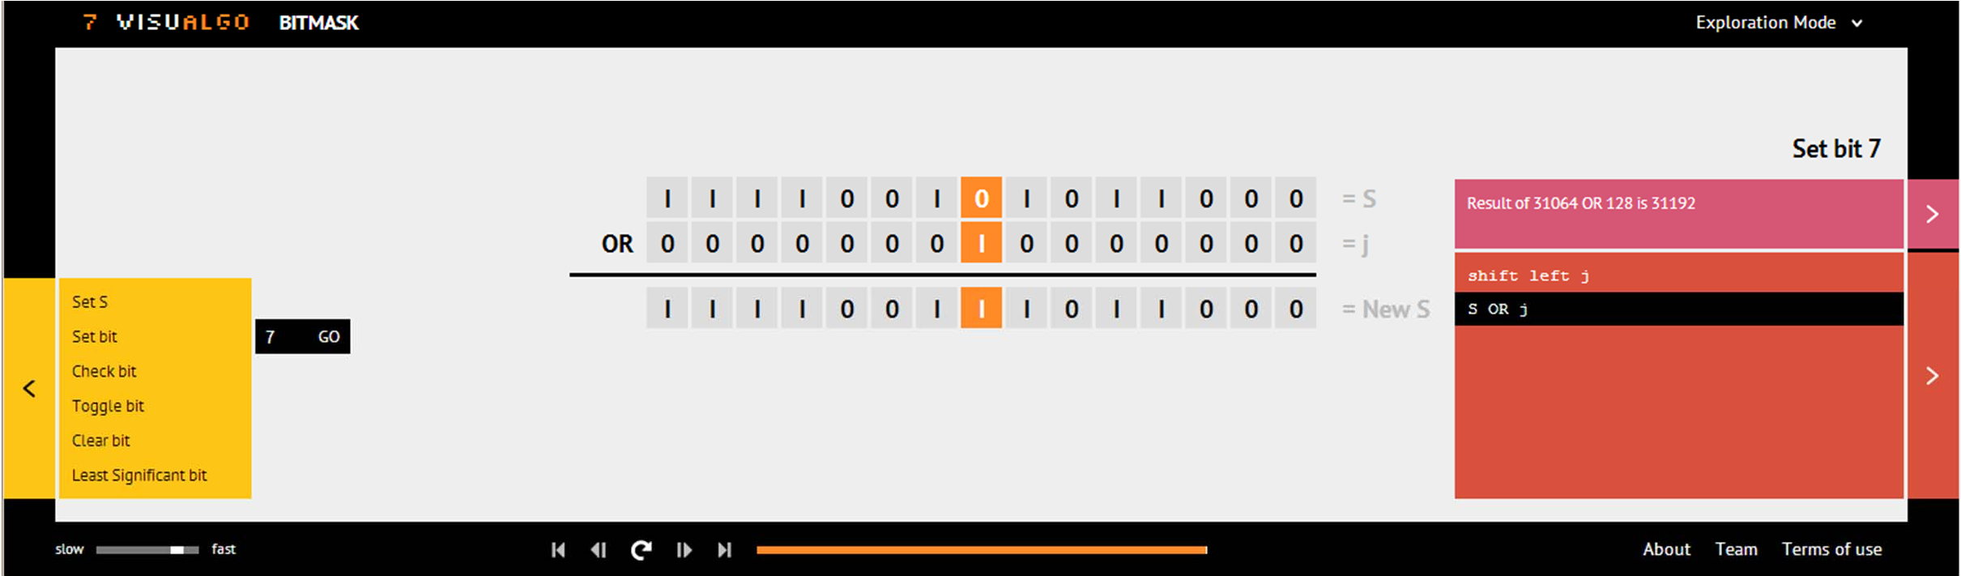
VisuAlgo Bitmask Exercise
First, click Click “Set S”, enter 31064, and click “Go” Explore “Set/Check bit”, enter 7, and click “Go”
Then self‐explore: Try other integer S and other integer j
Also, self‐explore “Toggle/Clear/Least Significant bit”

Slide 31
Introductory material
Note that graph will appear from now onwards (Week06‐13 :O)
GRAPH

Slide 32
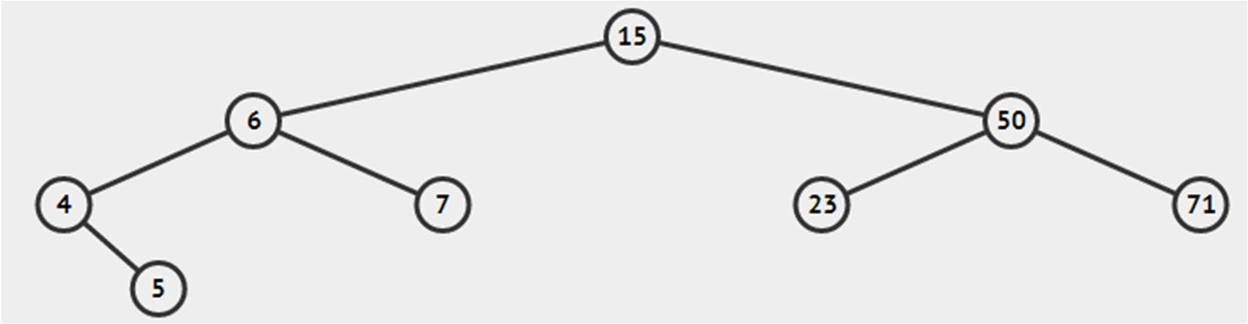
Graph Terminologies (1)
Extension from what you already know: (Binary) Tree
Vertex, Edge, Direction (of Edge), Weight (of Edge)
But in general graph, there is no notion of:
Root
Parent/Child
Ancestor/Descendant

Slide 33
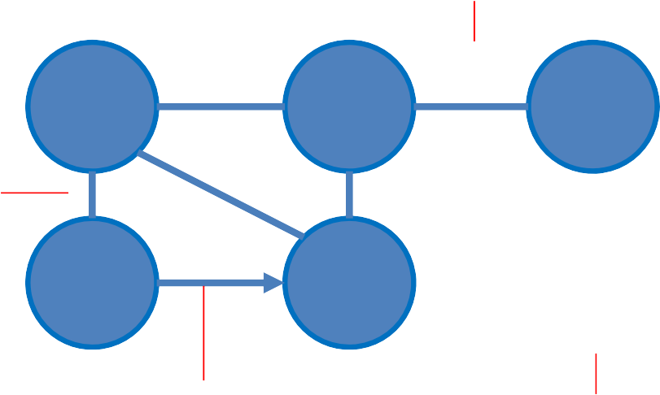
Graph is…
(Simple) graph is a set of vertices where some
[0 .. _{N}C₂] pairs of the vertices are connected by edges
We will ignore “multi graph” where there can be more than one edge between a pair of vertices
Weighted Undirected Edge
0
7
1 2
Undirected Edge Thus vertex 0 and vertex 3 are called “adjacent”
3
4
5
A vertex, usually labeled from 0 to V‐1
Directed Edge

Slide 34



Social Network

Slide 35
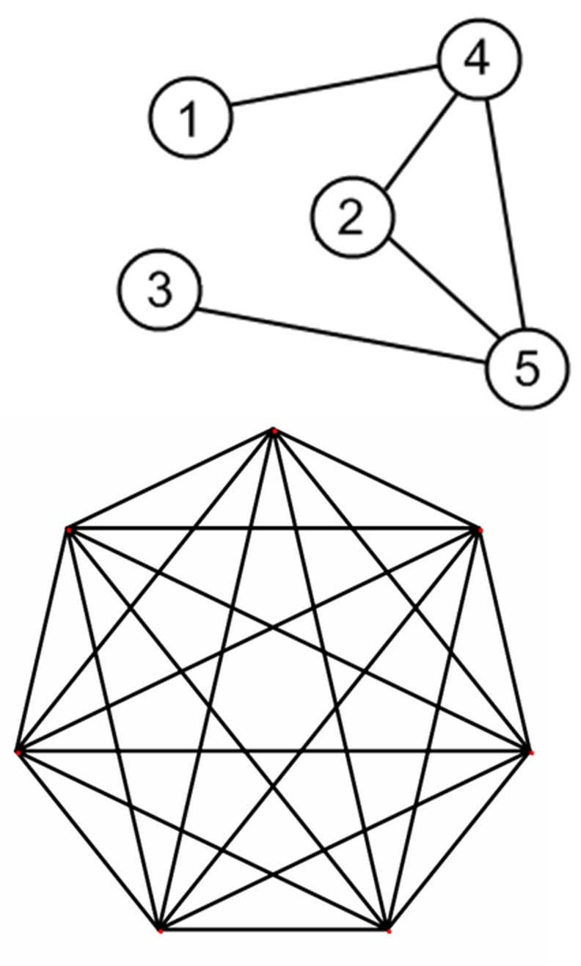
Graph Terminologies (2)
More terminologies (simple graph):
Sparse/Dense
Sparse = not so many edges
Dense = many edges
No guideline for “how many”
Complete Graph
Simple graph with
N vertices and _{N}C₂ edges
In/Out Degree of a vertex
Number of in/out edges from a vertex
Sparse Graph
In/out degree of vertex 5 = 3
Dense Graph
Complete Graph 7 vertices,
₇C₂ = 21 edges

Slide 36
Graph Terminologies (3)
Yet more terminologies (example in the next slide):
(Simple) Path
Sequence of vertices adjacent to each other
Simple = no repeated vertex
Path Length/Cost
In unweighted graph, usually number of edges in the path
In weighted graph, usually sum of edge weight in the path
(Simple) Cycle
Path that starts and ends with the same vertex
With no repeated vertex except start/end

Slide 37
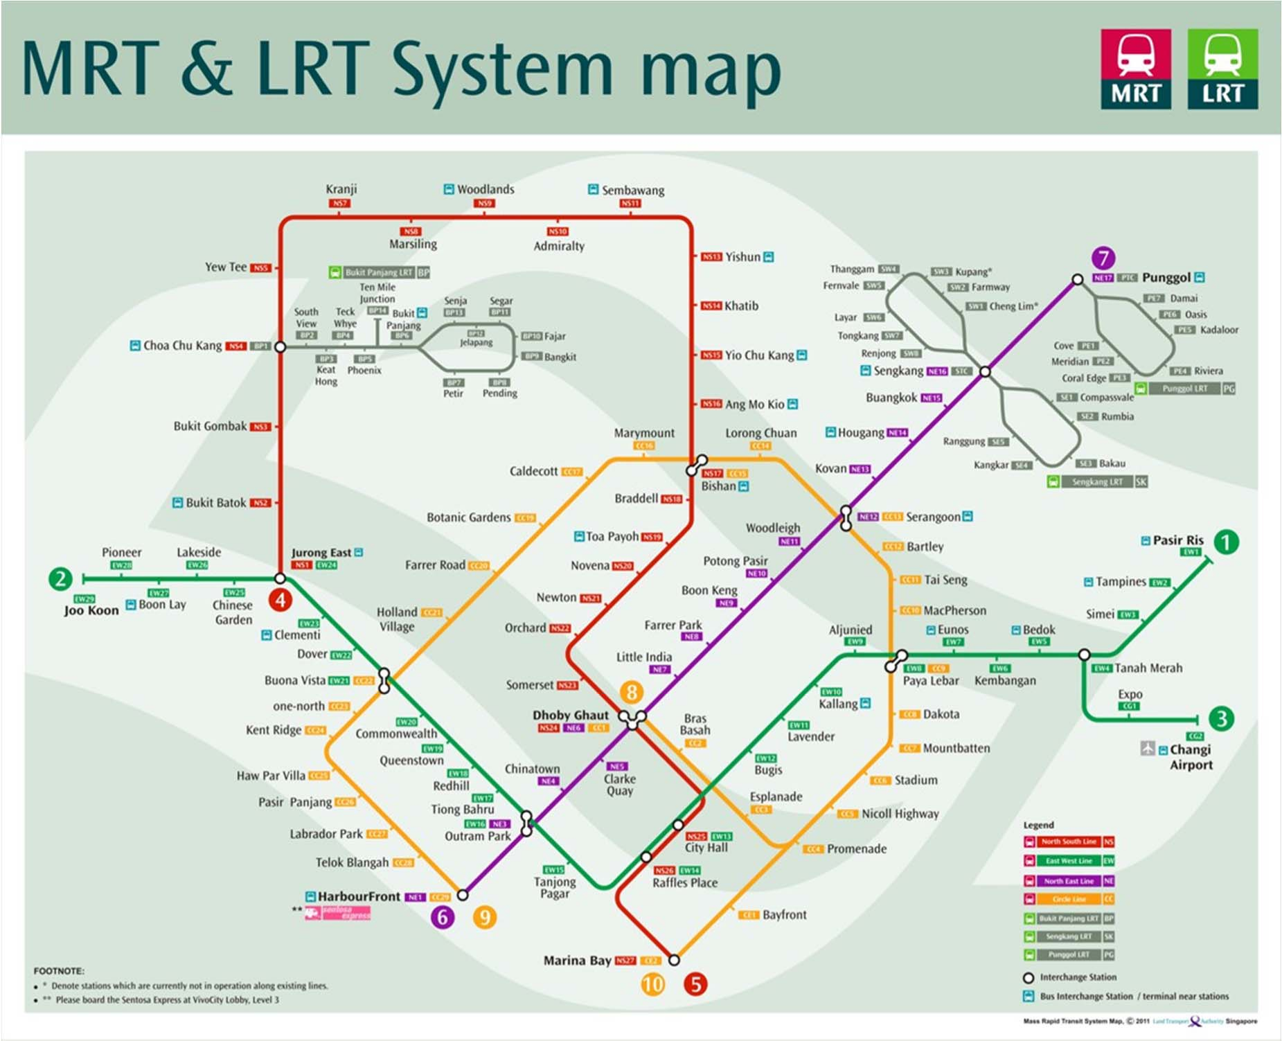


Transportation Network
Simple cycle
Sengkang LRT, west loop)
Simple path (from Clementi to Outram Park MRT) with length 7 (in terms of number of hops)

Slide 38



Internet / Computer Networks

Slide 39


Communication Network

Slide 40
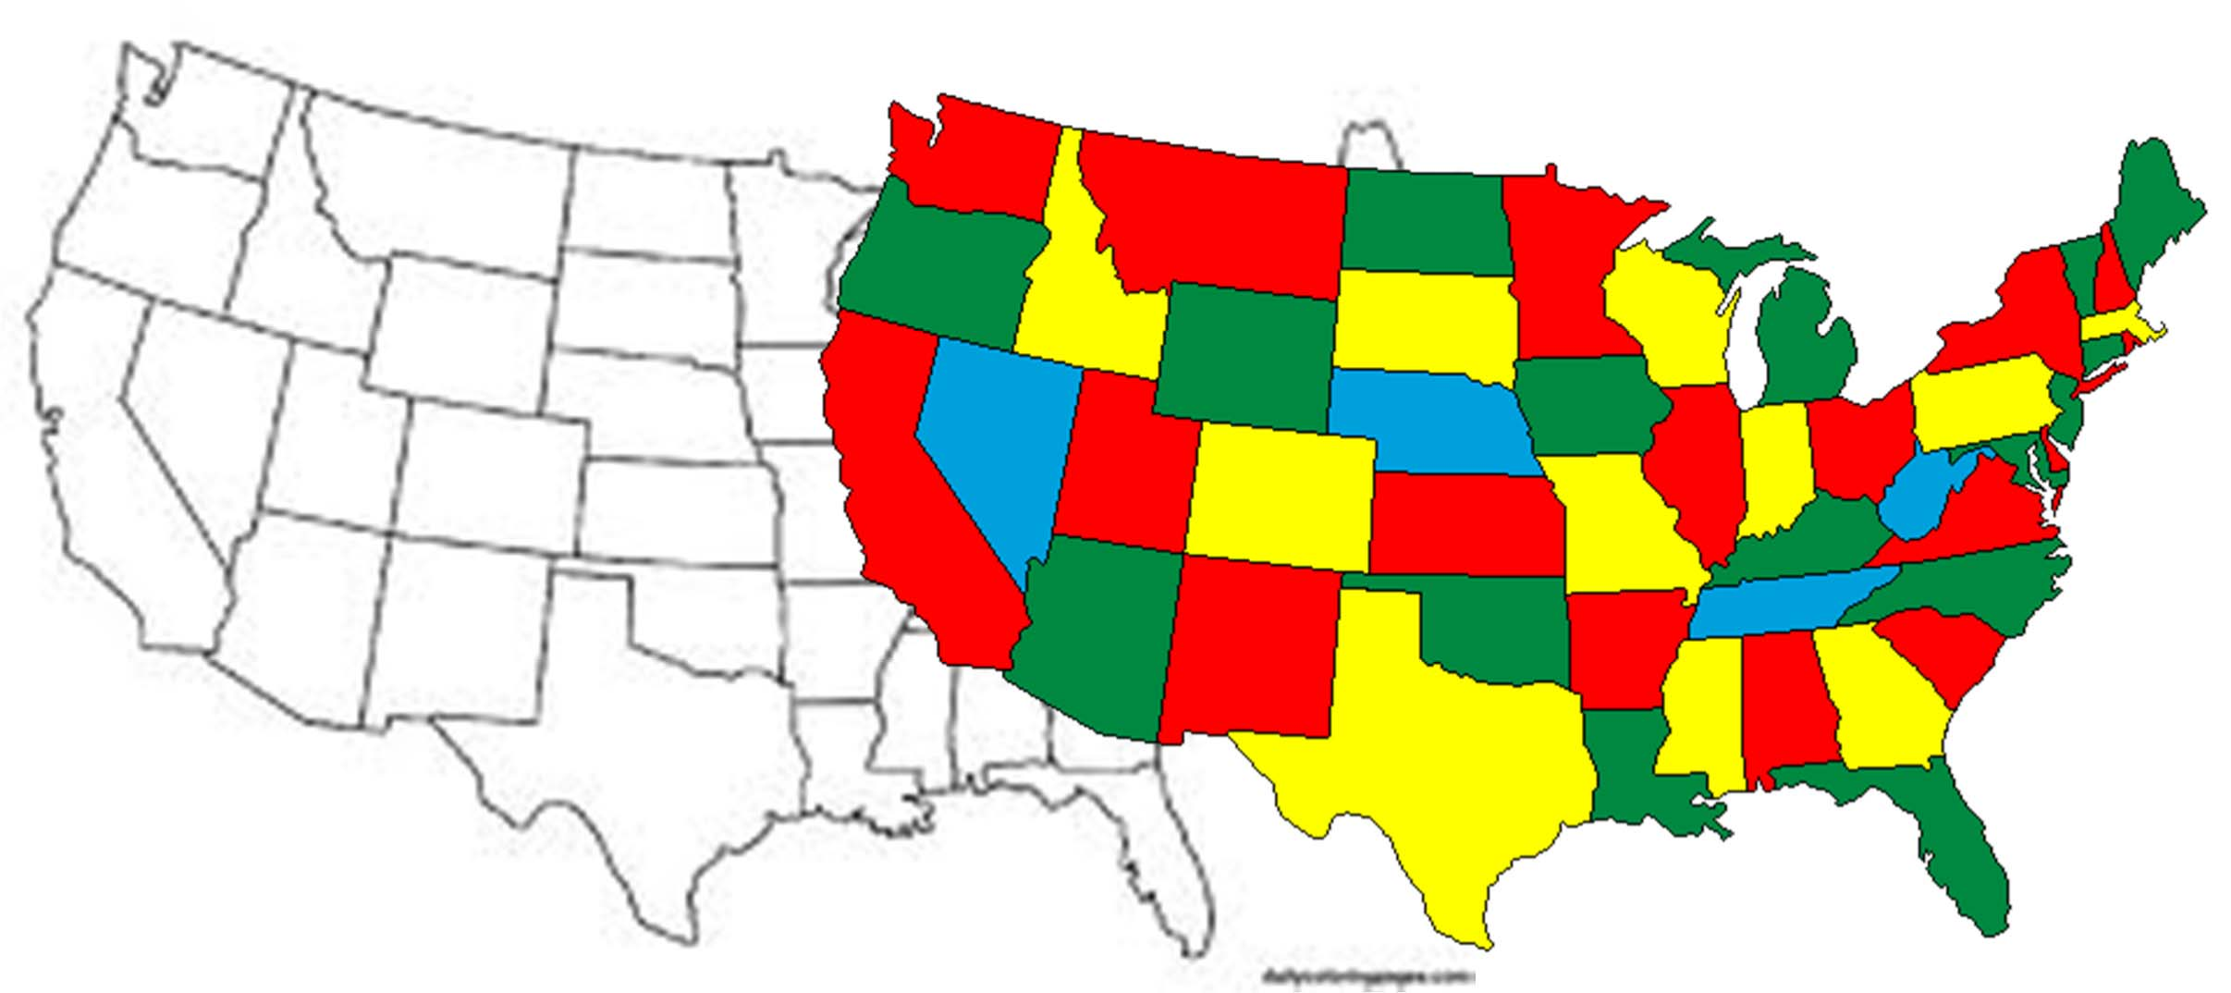
Optimization

Slide 41
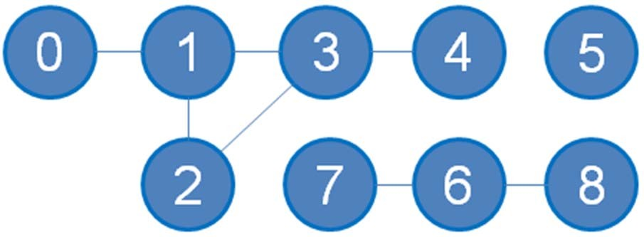
Graph Terminologies (4)
Yet More Terminologies:
Component
A group of vertices in undirected graph that can visit each other via some path
Connected graph
Graph with only 1 component
Reachable/Unreachable Vertex
See example
Sub Graph
Subset of vertices (and their edges) of the original graph
There are 3 components in this graph
Disconnected graph
(since it has > 1 component)
Vertices 1‐2‐3‐4 are reachable from vertex 0
Vertices 5, 6‐7‐8 are unreachable from vertex 0
{7‐6‐8} is a sub graph of this graph

Slide 42
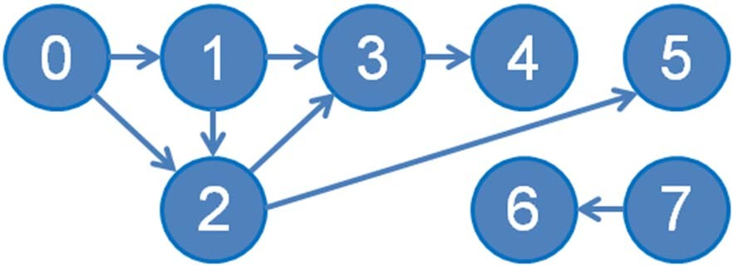
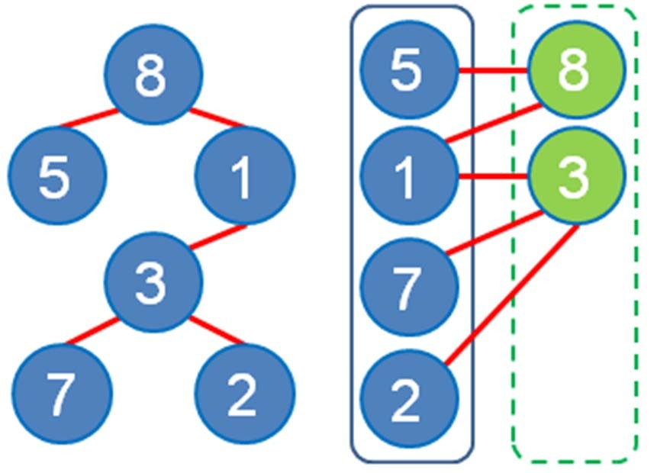
Graph Terminologies (5)
Yet More Terminologies:
Directed Acyclic Graph (DAG)
Directed graph that has no cycle
Tree (bottom left)
Connected graph, E = V ‐ 1, one unique path between any pair of vertices
Bipartite Graph (bottom right)
If we can partition the vertices into two sets so that there is no edge between members
of the same set
Out degree of vertex 0 = 2
In degree of vertex 2 = 2

Slide 43
Next, we will discuss three Graph DS http://visualgo.net/graphds.html
This DS will be revisited in Week 06‐13 :O (i.e. very important) Reference: CP3 Section 2.4.1
GRAPH DATA STRUCTURES

Slide 44
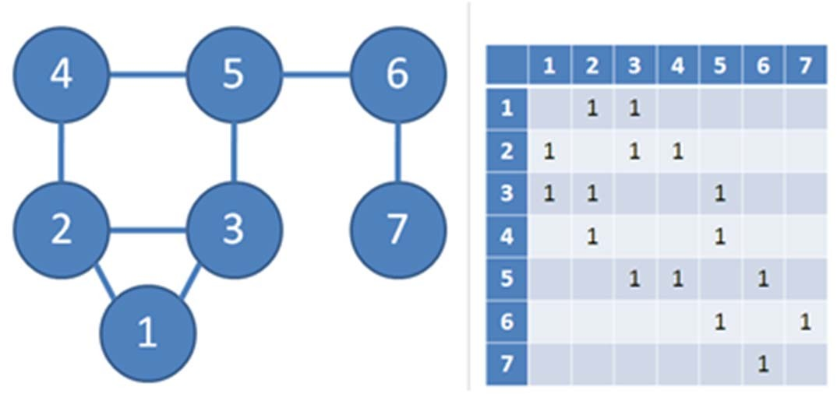
Adjacency Matrix
Format: a 2D array AdjMatrix (see an example below)
Cell AdjMatrix[i][j] contains value 1 if there exist an edge i→j in G, otherwise AdjMatrix[i][j] contains 0
For weighted graph, AdjMatrix[i][j] contains the weight of edge i→j, not just binary values {1, 0}.
Space Complexity: O(V²)
V is |V| =
number of vertices in G

Slide 45
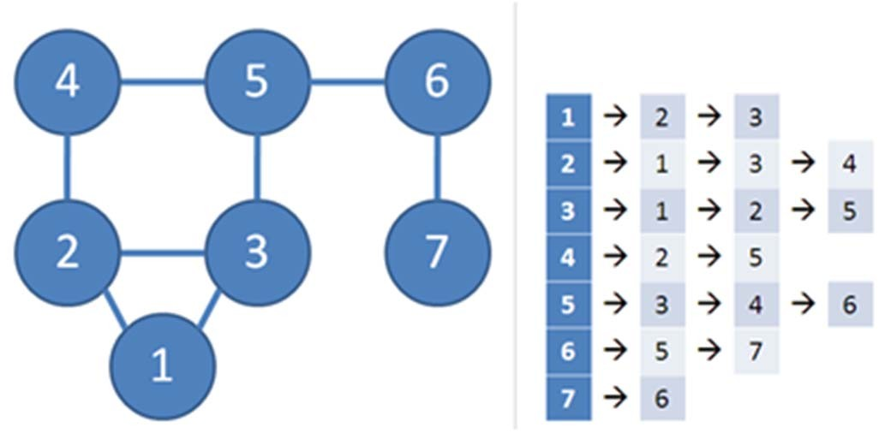
Adjacency List
Format: array AdjList of V lists, one for each vertex For each vertex i, AdjList[i] stores list of i's neighbors
For weighted graph, stores pairs (neighbor, weight)
– Note that for unweighted graph, we can also use the same strategy as the weighted version using (neighbor, weight),
but the weight is set to 0 (unused) or set to 1 (to say unit weight)
Space Complexity: O(V+E)
E is |E| = number of edges in G, E = O(V²)
V+E ~= max(V, E)

Slide 46
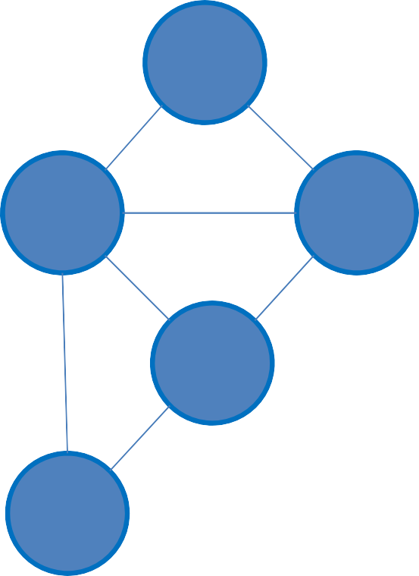
Edge List
Format: array EdgeList of E edges
For each edge i, EdgeList[i] stores an (integer) triple {w(u, v), u, v}
For unweighted graph, the weight can be stored as 0 (or 1), or simply store an (integer) pair
1
4
i | w | u | v
0 | 2 | 1 | 2
1 | 4 | 0 | 1
2 | 4 | 0 | 2
3 | 6 | 0 | 3
4 | 6 | 0 | 4
5 | 8 | 2 | 3
6 | 9 | 3 | 4
Space Complexity: O(E)
4
2
Remember, E = O(V²)
0
2
6
8
6
3
9
4

Slide 47
Java Implementation (1)
Adjacency Matrix: Simple built‐in 2D array
int i, V = NUM_V; // NUM_V has been set before int[][] AdjMatrix = new int[V][V];
Adjacency List: With Java Collections framework
Vector < Vector < IntegerPair > > AdjList = new Vector < Vector < IntegerPair > >();
// IntegerPair is a simple integer pair class
// to store pair info, see the next slide
Edge List: Also with Java Collections framework
Vector < IntegerTriple > > EdgeList = new Vector < IntegerTriple >();
// IntegerTriple is similar to IntegerPair
PS: This is my implementation, there are other ways

Slide 48
Java Implementation (2)
class IntegerPair implements Comparable<IntegerPair> { Integer _first, _second;
public IntegerPair(Integer f, Integer s) {
_first = f;
_second = s;
}
public int compareTo(IntegerPair o) {
if (!this.first().equals(o.first()))
// this.first() != o.first()
// is wrong!, we want to
// compare their values,
// not their references
return else
return
this.first() - o.first();
this.second() - o.second();
}
Integer first() { return _first; } Integer second() { return _second; }
}
// IntegerTriple is similar to IntegerPair, just that it has 3 fields

Slide 49
Java Implementation (3)
We will use AdjList for most graph problems in CS2010
Vector < Vector < IntegerPair > > AdjList;
Why do we use IntegerPair?
We need to store pair of information for each edge:
(neighbor number, weight), weight = 0/unused for unweighted graph
Why do we use Vector of IntegerPairs?
For Vector’s auto‐resize feature ☺: If you have k neighbors of a vertex, just add k times to an initially empty Vector of IntegerPair of this vertex
You can replace this with Java List or ArrayList if you want to…
Why do we use Vector of Vectors of IntegerPairs?
For Vector’s indexing feature ☺: if we want to enumerate neighbors of vertex u, use AdjList.get(u) to access the correct Vector of IntegerPairs

Slide 50
Summary
In this lecture, we looked at:
Union‐Find Disjoint Sets (UFDS)
for Week 07 later
Bitmask Data Structure
for Week 11 later
Graph terminologies + why we have to learn graph
for Week 06‐13 later :O…
How to store graph info in computer memory
PS: Online Quiz 1 next week includes UFDS, Bitmask, and Graph DS

Slide 51
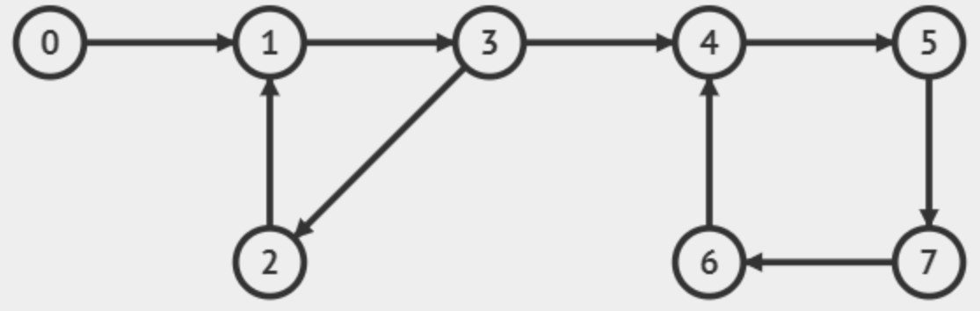
Revision
Đồ thị sau có mấy đỉnh, mấy cạnh?
Đây là đồ thị có hướng hay vô hướng, có trọng số hay không?
Đồ thị này có chu trình không?
Biểu diễn đồ thị dưới dạng ma trận kề và dưới dạng danh sách kề

